Slide 1

Social Science Research Design and Statistics, 2/e
Alfred P. Rovai, Jason D. Baker, and Michael K. Ponton
Within Subjects Analysis of Variance
PowerPoint Prepared by
Alfred P. Rovai
IBM® SPSS® Screen Prints Courtesy of International Business Machines Corporation,
© International Business Machines Corporation.

Slide 2
Uses of Within Subjects Analysis of Variance
The within subjects analysis of variance (ANOVA) is a parametric procedure that tests the hypothesis that there is no difference between the population means (μ) of three or more dependent groups on a single factor (i.e., one IV)
  Each of the levels of a within subjects factor is represented by a different variable.
  The dependent t-test is used to compare the means of two dependent groups on a single factor.
It also tests the hypotheses that there are no differences between the population means (μ) of two or more dependent groups on multiple factors (i.e., a factorial ANOVA) and that there are no interaction effects between factors.
This test is also known as a repeated measures ANOVA.

Slide 3
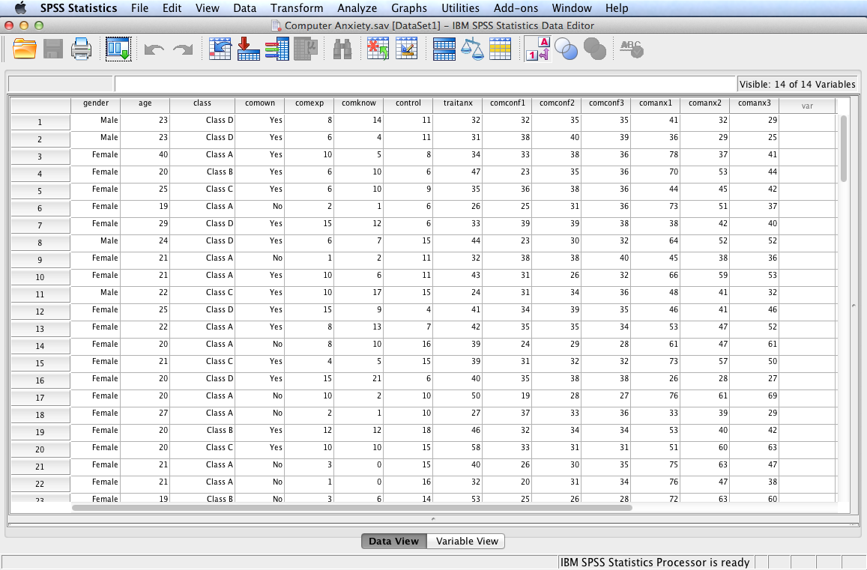
Open the dataset Computer Anxiety.sav.
File available at http://www.watertreepress.com/stats

Slide 4
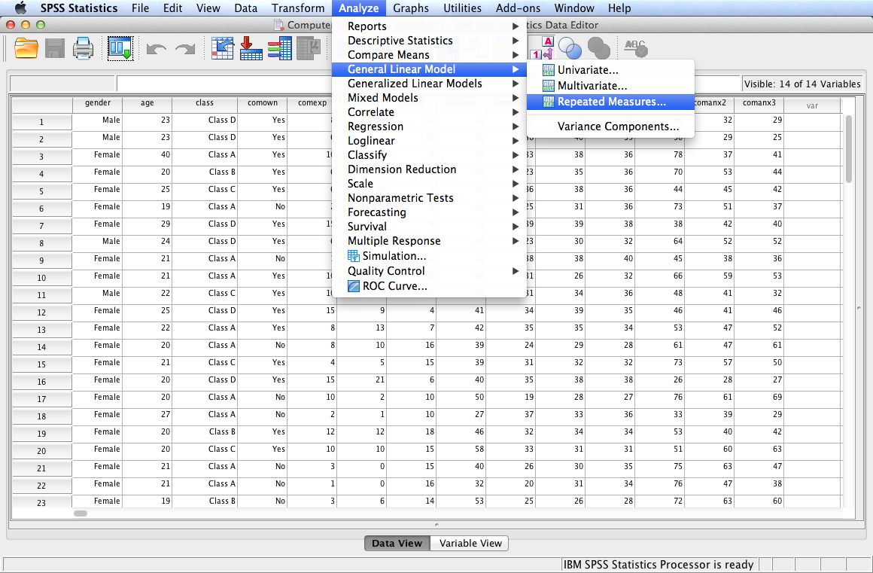
Follow the menu as indicated.

Slide 5
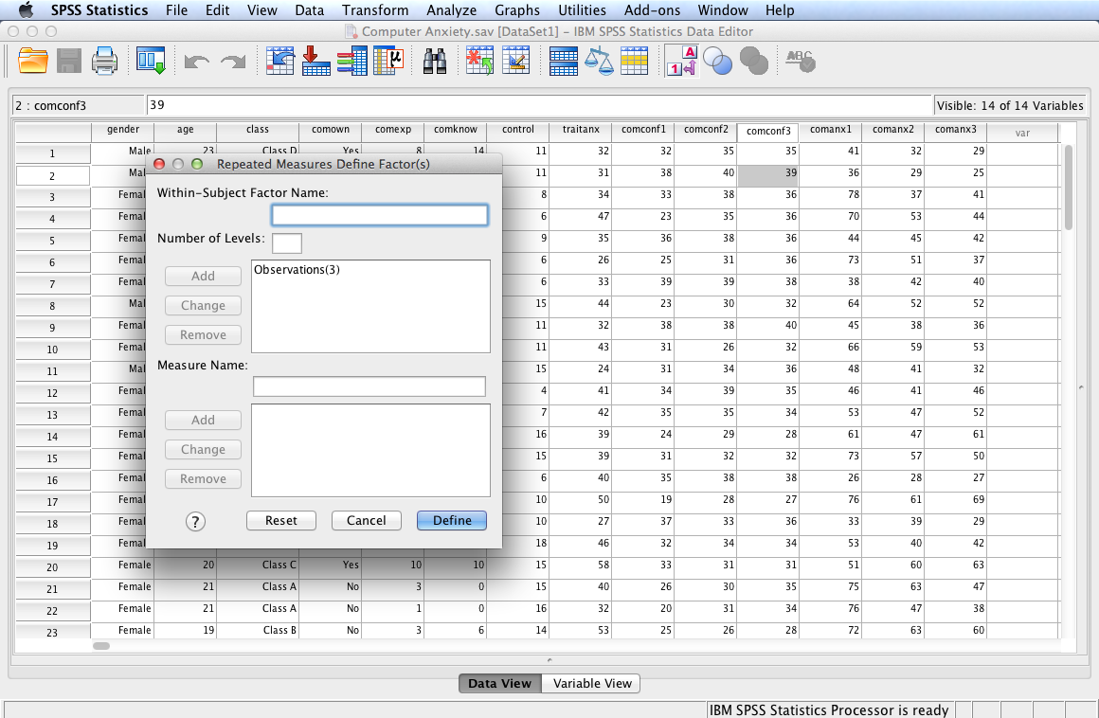
In this example, we will test the following null hypothesis:
H_{o}: There is no difference in mean computer confidence over time (observation 1, observation 2, and observation 3), μ₁ = μ₂ = μ₃.
Since there is only one within subjects factor (observations), this is a one-way within subjects ANOVA.
Enter Observations in the Within Subjects Factor Name: box (any descriptive name will do). Enter 3 in the number of Levels: box (there are three observations that will be analyzed). Click Add (this will set Observations(3) as the within subjects factor). Click Define.

Slide 6
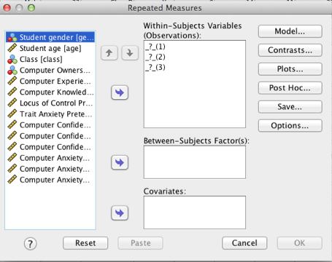
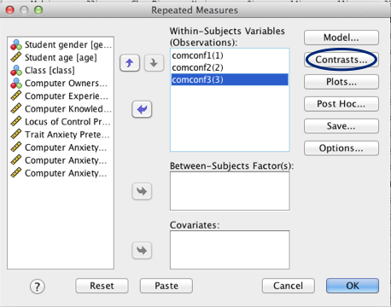
The purpose of this dialog is to define the three within subjects levels.
Move each of computer confidence levels to the Within Subjects Variables (Observations): box. Click Contrasts… to move on to the next dialog.
Note: skip the Model… dialog unless it is desired to specify a custom model (a full factorial model is the default).

Slide 7
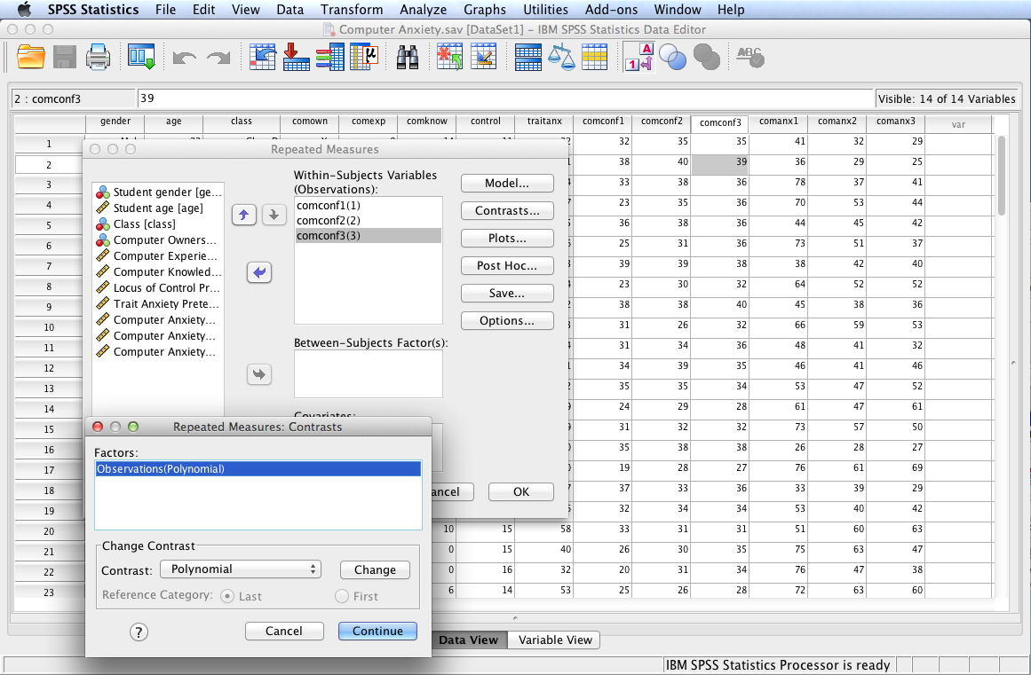
Confirm that orthogonal polynomial contrasts will be conducted as a post hoc test. Click Continue then click Plots.
Note: polynomial contrasts are appropriate following a significant within subjects ANOVA (post hoc multiple comparison tests are appropriate for any significant between subjects factor in a mixed design).

Slide 8
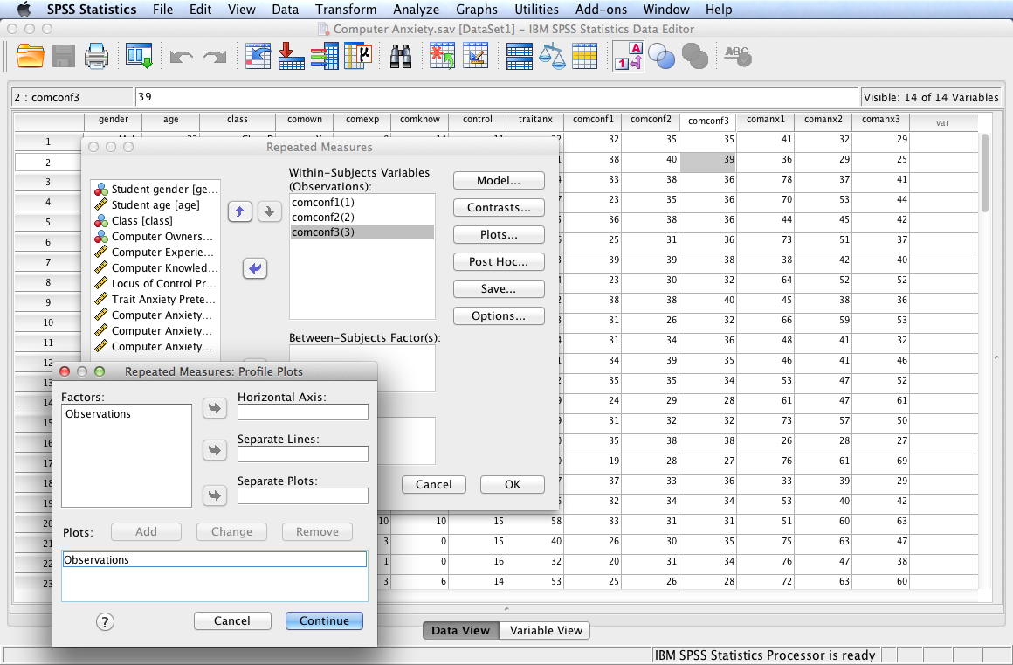
Use the Plots dialog to define a profile plot. Move Observations to the Horizontal Axis: box. Click Add (this action moves the factor to the Plots: box). Click Continue and then Options… to move to the Options dialog.
Note: skip the Post Hoc… dialog since post hoc multiple comparison tests are usually not required for a within subjects ANOVA since polynomial contrasts will be used as a post hoc test.
Also skip the Save… dialog unless it is desired to save values predicted by the model, residuals, and related measures as new variables in the Data Editor.

Slide 9
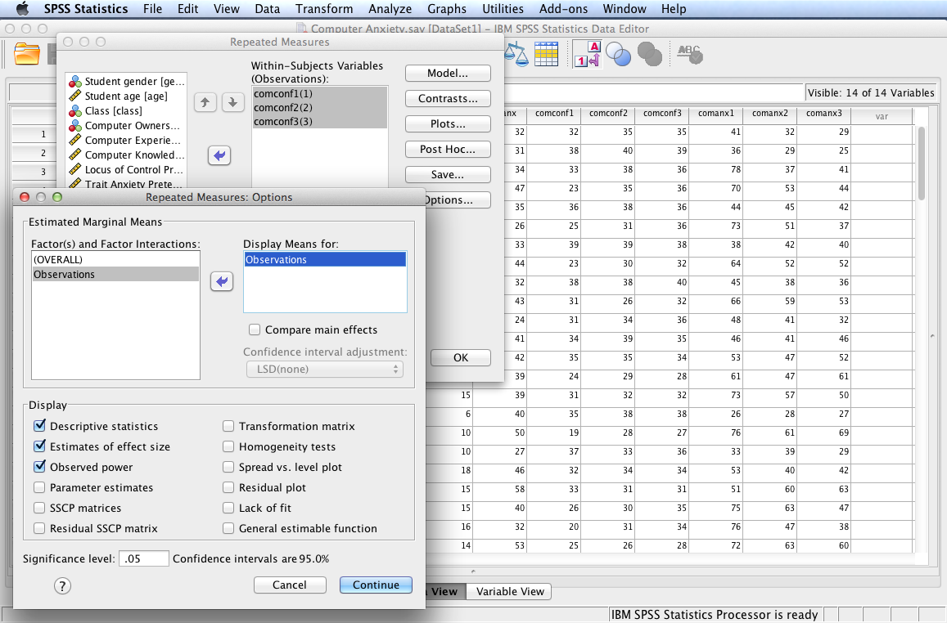
Use the Options dialog to identify additions to the SPSS output. Move Observations to the Display Means for: box. Check Descriptive statistics, Estimates of effect size, and Observed power. Click Continue then click OK to display SPSS output.
Note: Homogeneity tests are not required because there are no between subjects factors in this analysis.

Slide 10
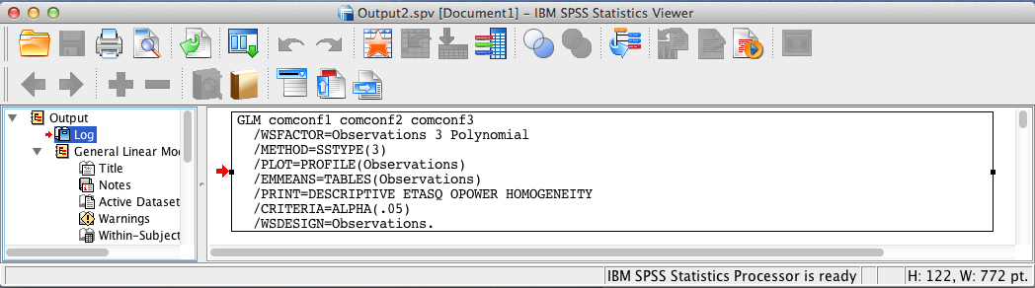
SPSS Output
The contents of the SPSS Log is the first output entry. The Log reflects the syntax used by SPSS to generate the General Linear Model output.

Slide 11
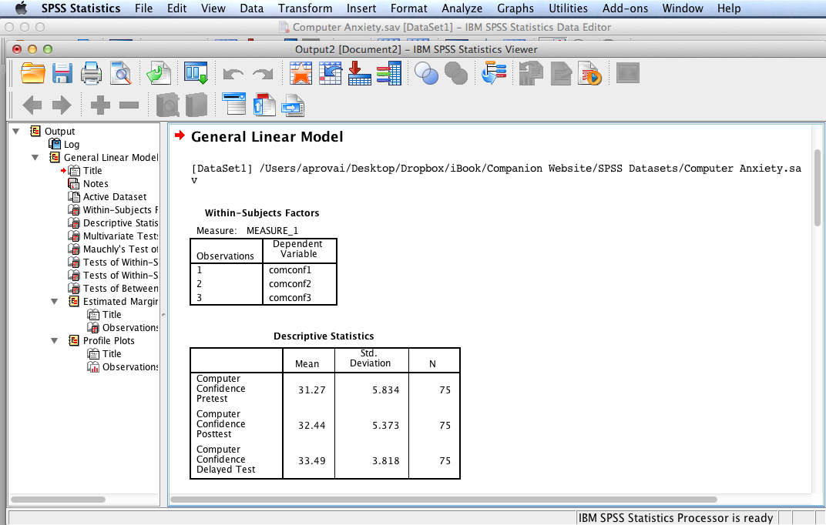
SPSS Output
SPSS output includes identification of the levels of the within subjects factor and descriptive statistics for each observation.
Note: the means are getting larger and the standard deviations are getting smaller for each subsequent observation suggesting computer confidence is increasing with less within observation variation over time.

Slide 12
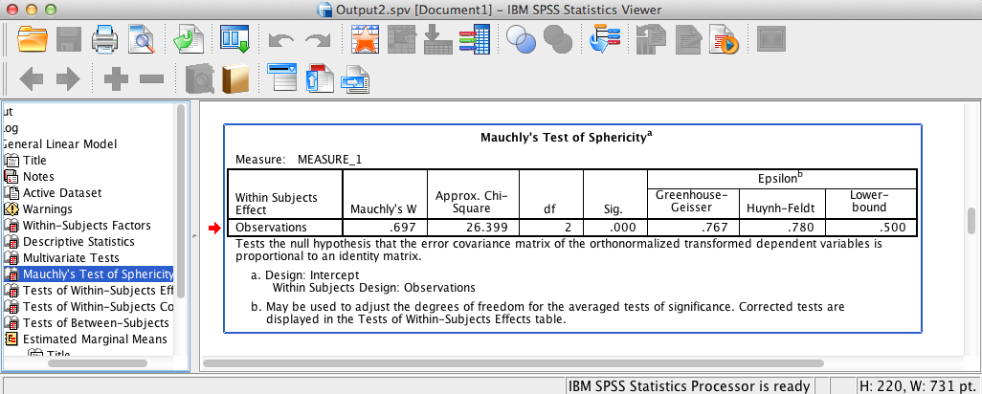
SPSS Output
Sphericity is tenable when the variance of the difference between the estimated means for any pair of groups is the same as for any other pair. The above SPSS output shows that Mauchly’s test is significant and therefore the assumption of sphericity has been violated, χ²(2) = 26.40, p < .001. Consequently, degrees of freedom should be corrected based on the value of epsilon (ε). Epsilon is a measure of the extent to which a variance-covariance matrix departs from sphericity. When  = 1 the matrix is perfectly circular, and becomes smaller than 1 with departures from sphericity. If ε > 0.75, use the Huynh-Feldt correction (the case here); if ε < 0.75, use the Greenhouse-Geisser correction.

Slide 13
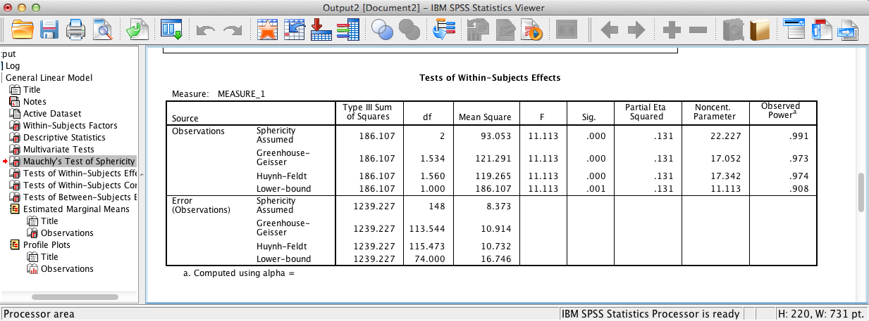
SPSS Output
The above SPSS output shows a significant within subjects effect for observations. Consequently, the test provides evidence that the null hypothesis of no difference in mean computer confidence over time can be rejected, F(1.56, 115.47) = 11.11, p < .001, η_{p}² = .13. In the above case, the Hunyh-Feldt correction is used because ε > 0.75

Slide 14
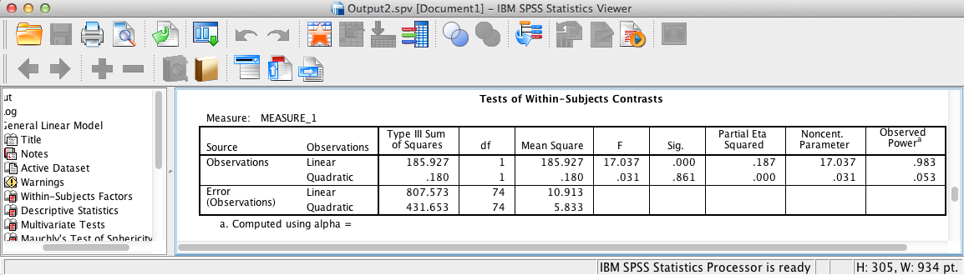
SPSS Output
The above SPSS output provides the results of polynomial contrasts for the within subjects conditions. The linear trend is significant, p < .001, but the quadratic trend is not, p = .86. The linear SS is 185.927, which accounts for 185.927/(185.927 + .180) = 99.90% of variability between the two trends. Consequently, the relationship among the three observations is mostly linear. This will be evident when one inspects the profile plot below.

Slide 15
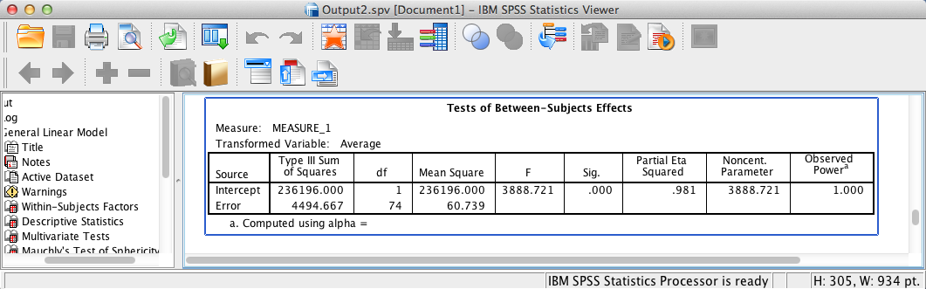
SPSS Output
This output displays the tests of between subjects factors. Since there are no between subjects factors in the present model, this table can be ignored.
Note: the Intercept effect is testing whether the sum of the three observations is different from zero. Since p < .001, one can conclude the sum is not equal to zero.

Slide 16
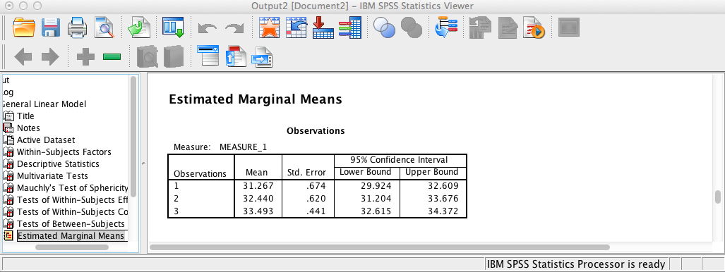
SPSS Output
This table provides confidence intervals centered on each category’s mean separately.

Slide 17
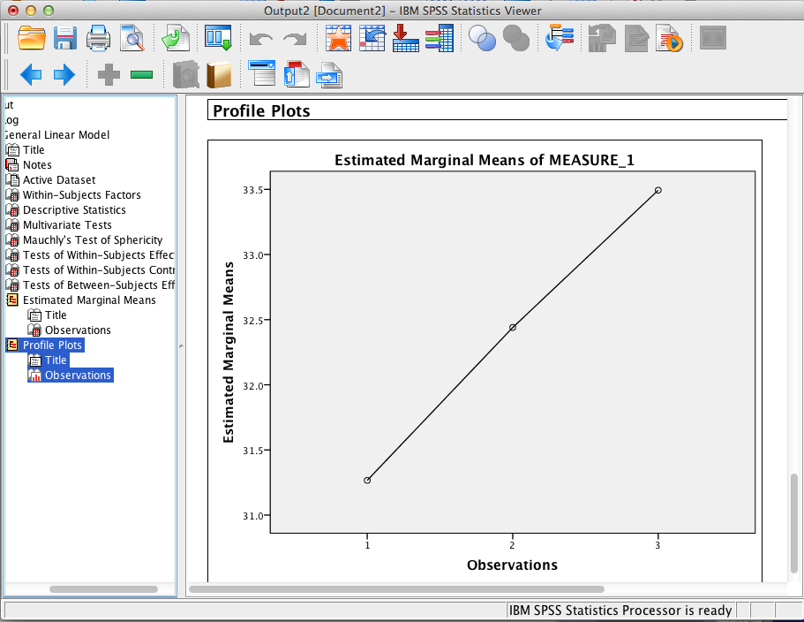
SPSS Output
This profile plot clearly displays the linear relationship of the within subjects conditions as indicated by the polynomial contrasts. Moreover, the slope of the line shows that computer confidence is increasing across the three observations.

Slide 18
Within Subjects ANOVA Results Summary
H₀: There is no difference in mean computer confidence over time (observation 1, observation 2, and observation 3), μ1 = μ2 = μ3. The within subjects ANOVA is significant, F(1.56,115.47) = 11.11, p < .001, η_{p}² = .13. Consequently there is sufficient evidence to reject the null hypothesis of no difference in mean computer confidence over time. However, results must be interpreted with caution because of a normality issue.
The Kolmogorov-Smirnov test with Lilliefors significance correction provides evidence that the distribution of the difference between observations 1 and 2 is approximately normally distributed, D(75) = .08, p = .20. However, the differences between observations 1 and 3, D(75) = .12, p = .006, and observations 2 and 3, D(75) = .15, p < .001, are not. The standard coefficients of skewness and kurtosis show skewness and kurtosis are normality issues only for the difference between observations 2 and 3 (skewness = –3.03, kurtosis = 3.35). Although repeated measures ANOVA is robust to violations of normality, test results should be interpreted with caution. The researcher should consider conducting the Friedman test, a nonparametric equivalent of the one-way within subjects ANOVA.

Slide 19
End of Presentation

